Slide 1
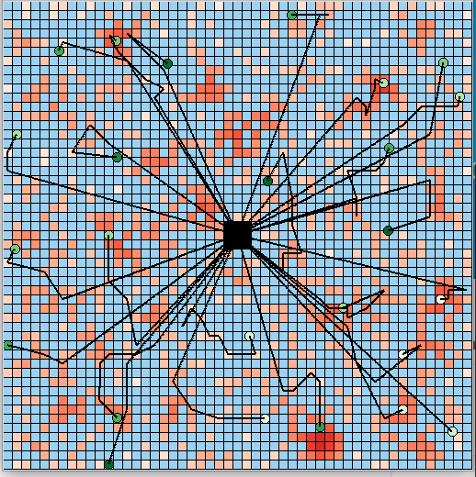
Swarm Information Foraging to Develop Forest Inventories
Dhruva Arun
DISTRIBUTION A: Approved for public release, distribution is unlimited.

Slide 2
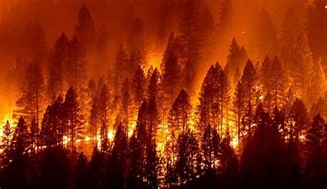
Problem Description
Wildfires are dangerous
Trajectory with Tree Attributes
Diameter at Breast Height (DBH) is important
Build trend, predict DBH
Current Solutions

Slide 3
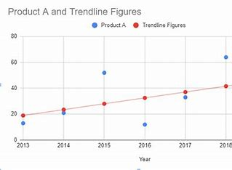
Swarm Objective
Build Trend
Selectivity
Compare different selection algorithms

Slide 4
Simulation
Manitou Experimental Forest Database
Home Area
Fuel Limitations
5 UAVS (Selectivity)

Slide 5
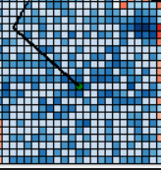
UAVS
Limited Spatial Access
Overlay Potential Fields
Proximity
Information Value
Weighted Sum

Slide 6
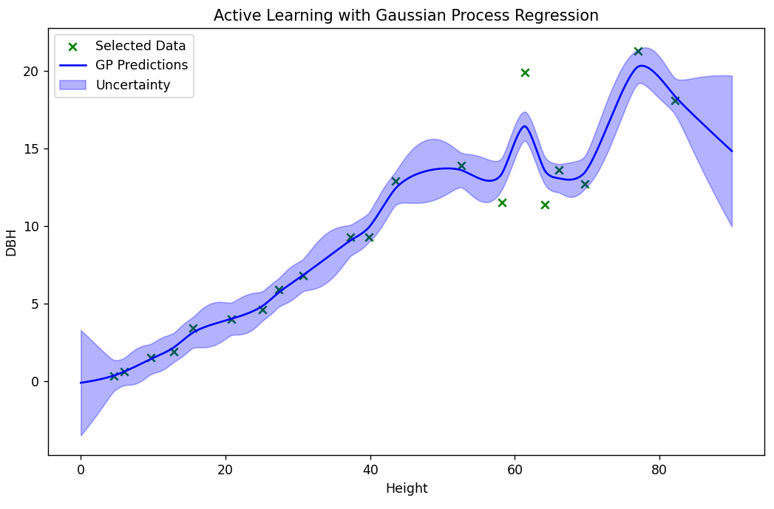
Gaussian Regression?
Gaussian Regression fits data points and tracks uncertainty
Performance Metric: MSE between predicted DBH and actual DBH

Slide 7
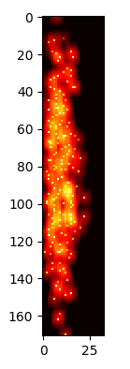
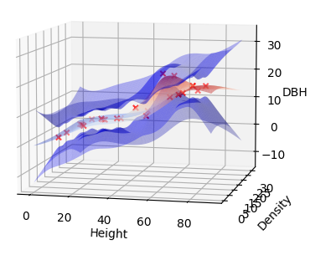

Information Algorithms

Slide 8
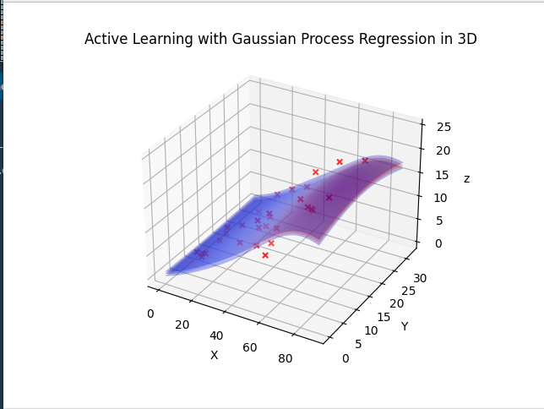
Initial Gaussian
Low and Constant uncertainty
No correlation between density and DBH

Slide 9
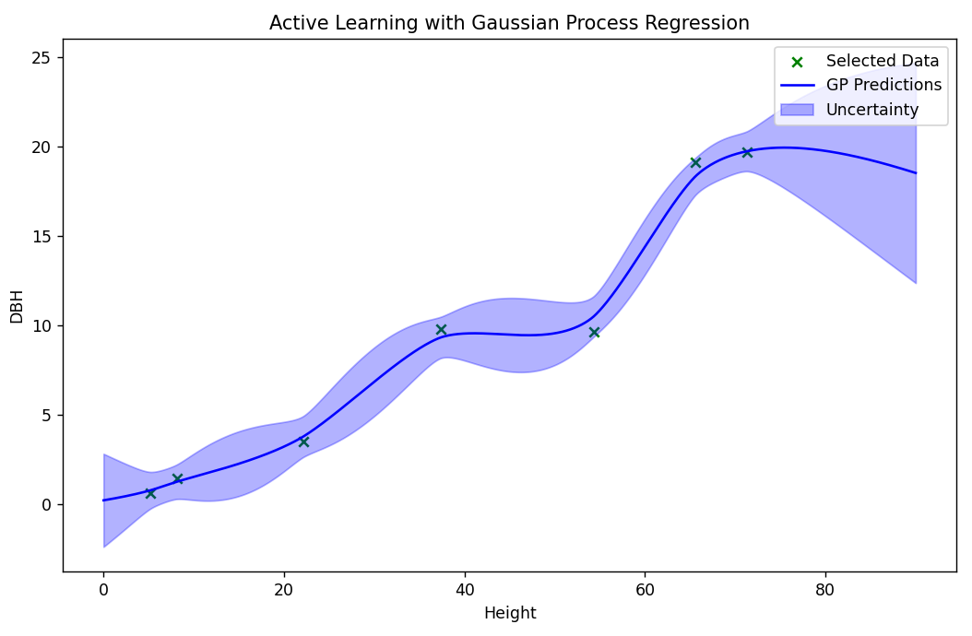
Gaussian Tuning

Slide 10
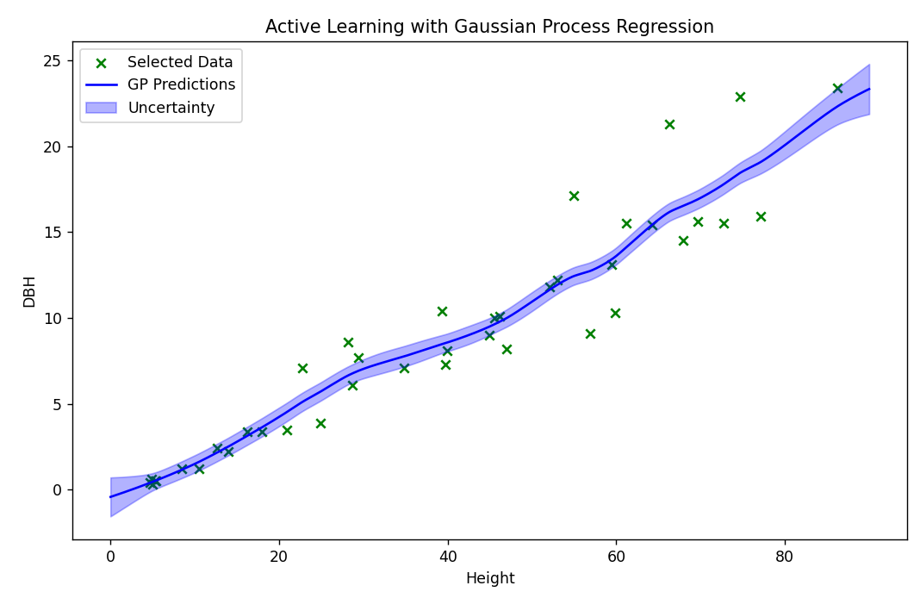
Gaussian Tuning (Continued)

Slide 11
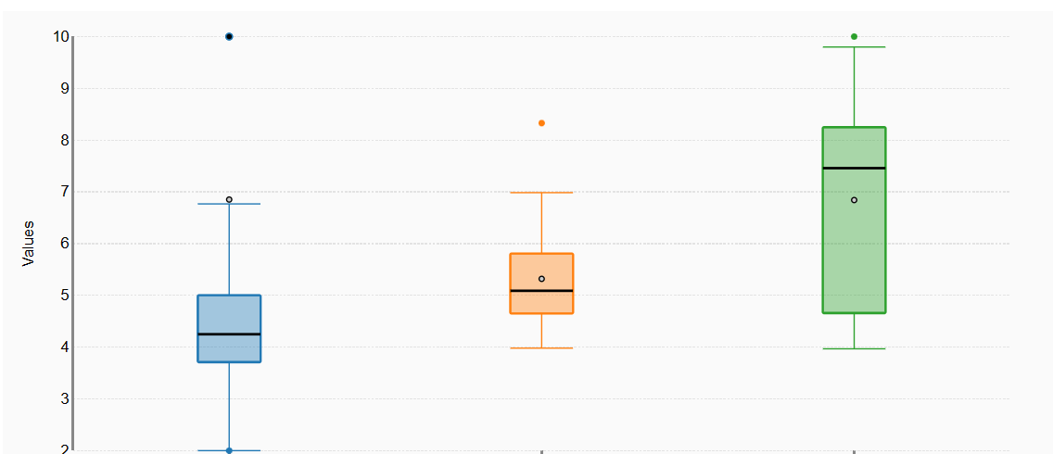
Results
Performance Metric: MSE of predicted DBH and actual DBH
Gaussian performed best
Powerful tool for information foraging
Not scalable, future segmentation?
More variables, better results
Gaussian, Threshold, Random

